Slide 1

Welcome to our presentation
Presented BY:
Group-I
Acknowledgement:
We extend our heartfelt gratitude to Mr. Ranjan KC and Mr. Sabin Shrestha for their invaluable guidance and support. Their expertise and assistance were instrumental in making this project a reality. Without their generous contributions, this endeavor would have been insurmountable.

Slide 2

Acknowledgement:
We extend our heartfelt gratitude to Mr. Ranjan KC and Mr. Sabin Shrestha for their invaluable guidance and support. Their expertise and assistance were instrumental in making this project a reality. Without their generous contributions, this project would have been impossible.

Slide 3
Acknowledgement:
We extend our heartfelt gratitude to Mr. Ranjan KC and Mr. Sabin Shrestha for their invaluable guidance and support. Their expertise and assistance were instrumental in making this project a reality. Without their generous contributions, this project would have been impossible.
Did you know?
Studies indicate that in some cities, up to 30% of traffic congestion is caused by drivers searching for parking spots.
The hunt for parking not only wastes time but also contributes to environmental pollution. In urban areas, cars circling for parking spots can add a significant amount of unnecessary emissions to the atmosphere.

Slide 4
Solution for it
SMART
PARKING
IOT
BASED

Slide 5

Content:
Introduction
Device and technology used
Working methodology
Results
Feasibility Study
Conclusion

Slide 6

What is I0T based smart parking ?
A smart parking system based on I0T is a game-changer for urban drivers as:
It uses sensors, networks, and software to show real-time parking availability
Drivers can use apps or displays to find and book parking spots
Makes parking easier and faster
Piezoelectric sensor
Why is it needed?
• Faster access to parking
• Optimization of space
• Reduce carbon emission
• Manage traffic

Slide 7
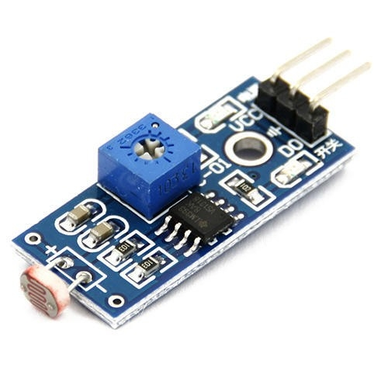
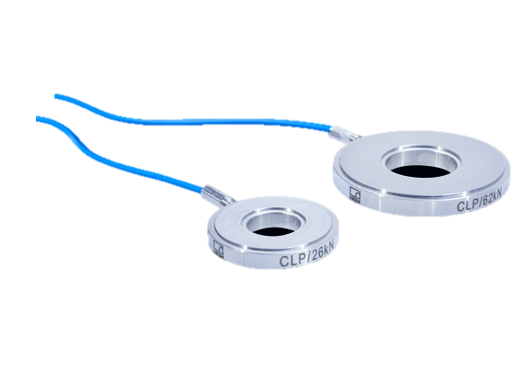
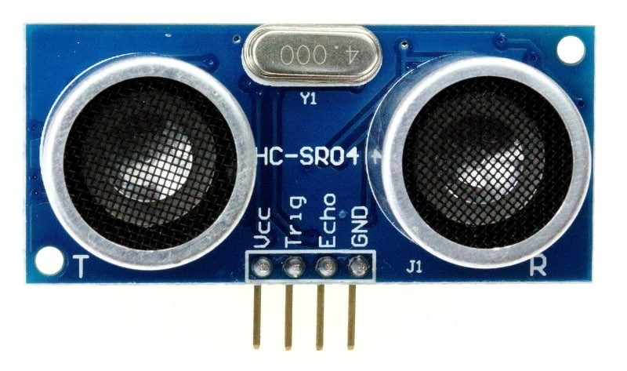
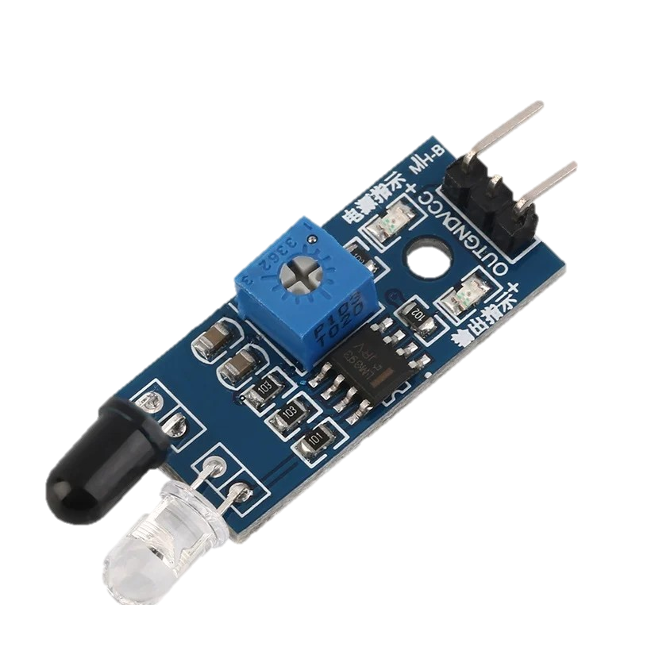
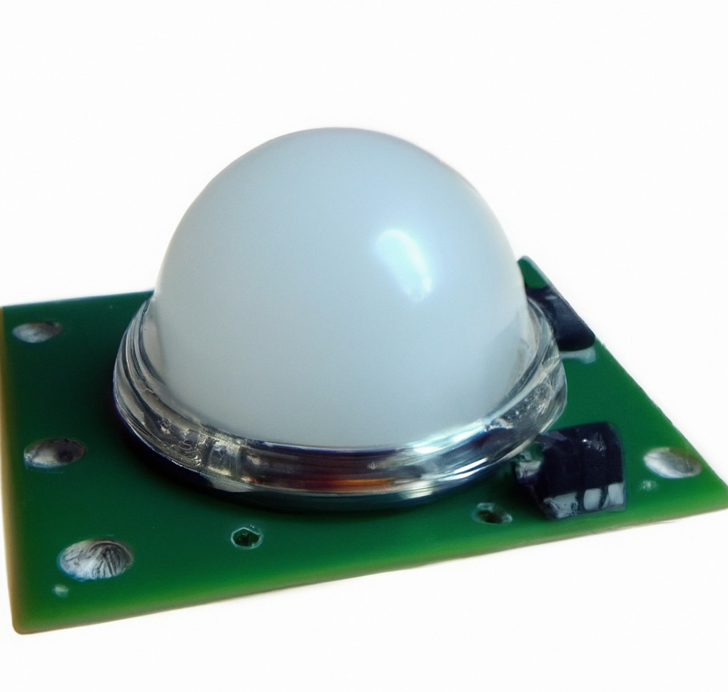
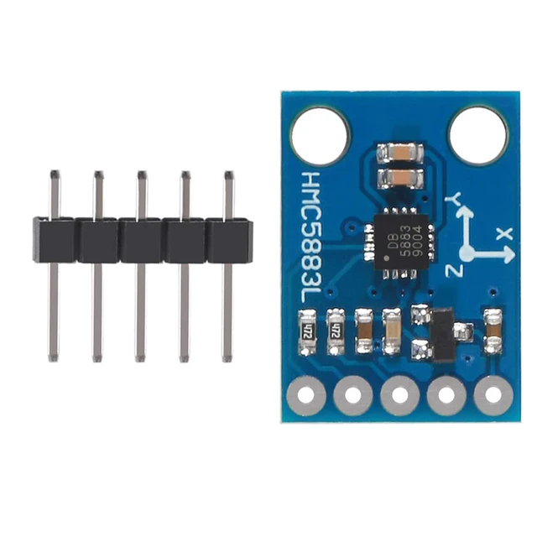
DEVICE AND SENSOR USED

Slide 8
Piezoelectric sensor
The sensors go under the parking spots
The sensors also help the system keep track of which spots are free
They send this information to a central place. so drivers can find empty spots easily.
Parking operators can use these sensors to manage their spaces better.

Slide 9
Ultrasonic Sensors:
Distance Measurement: Utilizes sound waves to measure distances accurately, enabling detection of vehicles within parking spaces.
Adaptable in Conditions: Functions effectively in different lighting and weather conditions, ensuring reliable detection regardless of environmental variations.

Slide 10
LDR sensor:
A Light Dependent Resistor, or LDR, measures how bright the light is.
The less light there is, the more resistance it has and vice versa
We can use this to detect changes in shadows

Slide 11
Active Infrared Sensor
It is designed in such a way that it emits infrared radiation and calculates a time when that radiation is reflected back from that sole object.
It can be used to detect the free space in a parking lot.

Slide 12
Magnetometer Sensors:
Magnetic Field Sensing: Detects changes in the Earth's magnetic field caused by vehicle presence, enabling accurate parking space occupancy detection.
Reliable Performance: Works well in various environmental conditions, ensuring consistent and dependable detection capabilities.

Slide 13
Passive IR sensor:
The temperature difference between the objects and the surroundings is what passive IR sensors detect.
They are often installed on the parking lot ceiling to sense temperature changes.
Weather conditions can affect how well passive IR sensors work

Slide 14
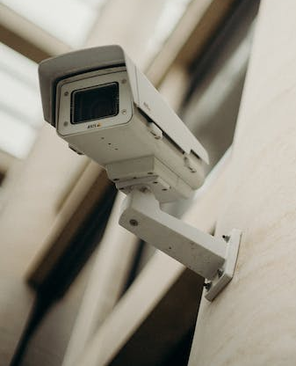
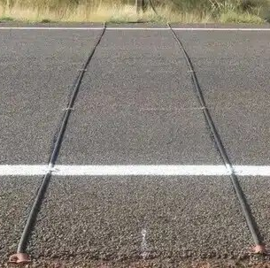
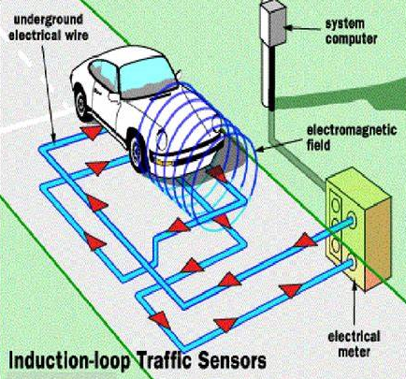
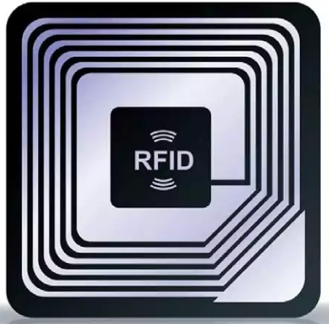
SYSTEM USED
Inductive loop detector
Pneumatic road tube
CCTV and image processing system
RFID
Technology used
Machine learning
Web development
Cloud computing
RFID
CCTV
Pneumatic road tube
Inductive loop detector

Slide 15
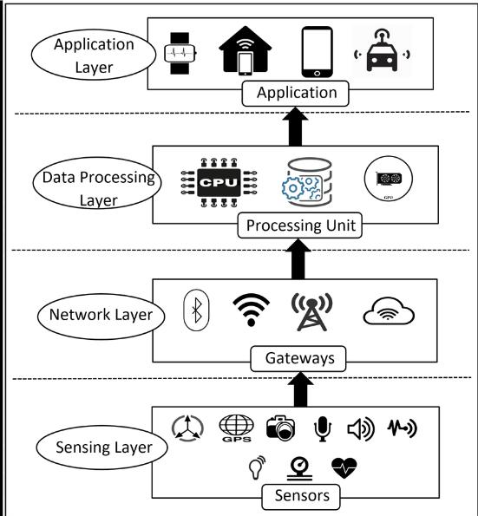
Working layers of Smart Parking System (SPS):
Sensing Layer:
Backbone of SPS for data input and includes sensors and receiver.
Network layer:
Key part of SPS, which transfers real-time information for a seamless transfer of data
Processing layer:
Brain of SPS
Process the received data with complex algorithms and provide answer to the users request.
Application layer:
Interfaces with which users connect and communicate
Abstraction is maintained and processed data is received in simple format

Slide 16
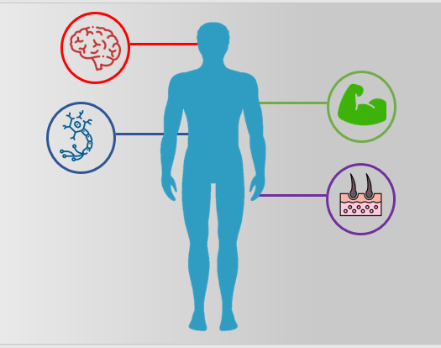

Slide 17
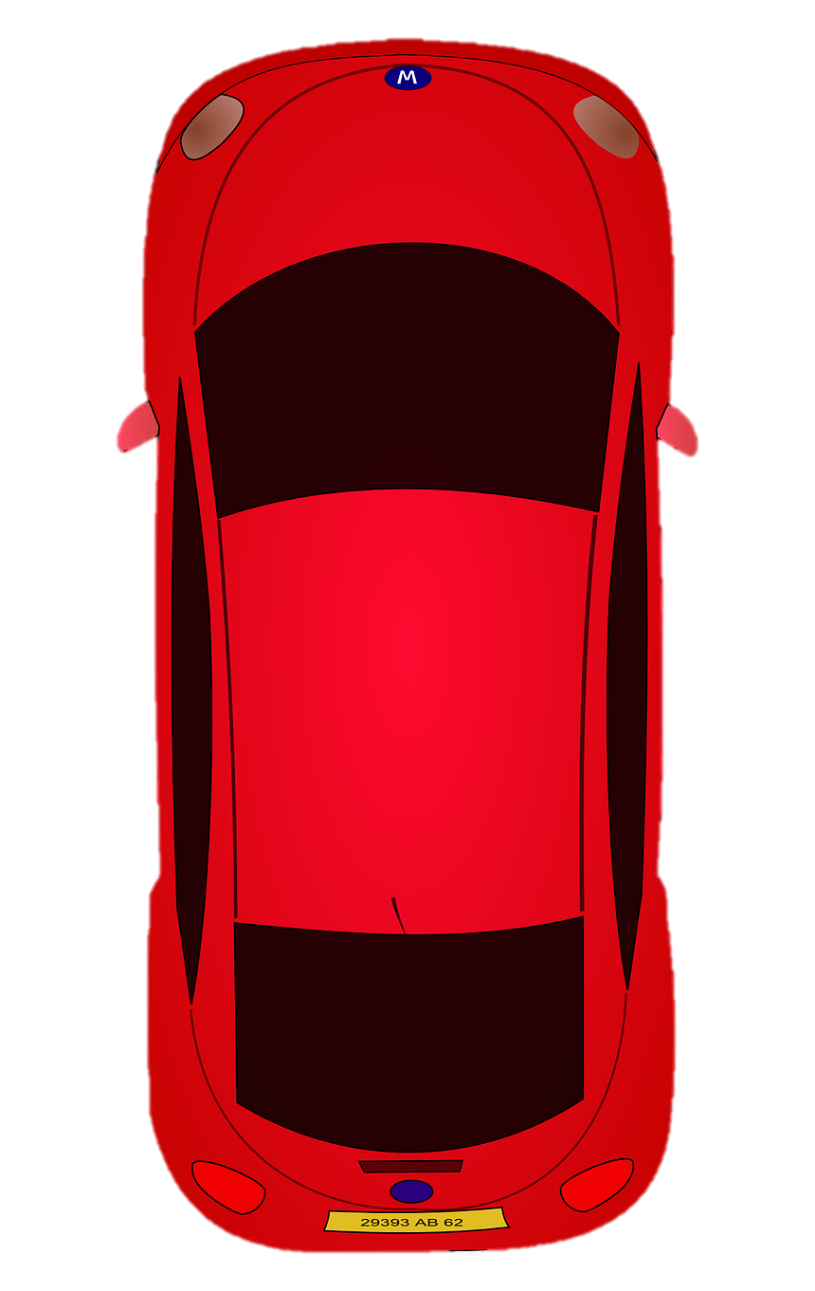

Slide 18
Where,
Spot is vacant
Spot available

Slide 19
Vehicle arrival
Sensor detection
Spot
available?
Parking starts
Payment
Gate Access
Vehicle exits
Gate Opens

Slide 20
RESULTS:
CONS:
Potential risk of wild life due to advanced technology like radiation from 5G tower and more
Deforestation
Eye damage and skin burn due to long term exposure to infrared sensors
High energy and resources used in the project
PROS:
Reduces carbon emission by reducing parking delay
Improvement of traffic flow
Optimization of space for parking
promote carpooling and eco-friendly practices
improved revenue and security

Slide 21
Risk Analysis
Poor communication and data encryption
Problem for path optimization and for self-driven car routes
Need Of Long range low power wide area networks(LPWAN) and 50 network
Follows First-come-First-serve system leading to among drivers
Needs high maintenance
Scalability issues may arise in multi-parking system
Accuracy issues with increasing relays
FEASIBILITY STUDY
IOT based parking system though approved by the UNO, it has not been
implemented in the world. Only 1-2 features have been implemented
throughout the world and each feature have multiple back draws.
> Let's dive deeper into the factors and underlying causes outlined within this
feasibility study:
Human Resources analysis
• Environmental impact
• Risk Analysis
• Technical Defects
• Recommendation/Suggestion
• Cost-Benefit Analysis

Slide 22
